Slide 1
CP Level 2 - Python
Life is short
(You need Python)

Slide 2
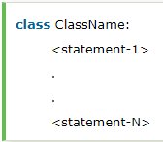
Chapter 9 OO and Libs
Object-Oriented Programming Concepts:
Object
The object is an entity that has state and behavior. It may be any real-world object like the mouse, keyboard, chair, table, pen, etc. Everything in Python is an object, and almost everything has attributes and methods.
Class
The class can be defined as a collection of objects. It is a logical entity that has some specific attributes and methods. For example: if you have an employee class then it should contain an attribute and method, i.e. an email id, name, age, salary, etc.

Slide 3
Chapter 9 OO and Libs
Object-Oriented Programming Concepts:
Method
The method is a function that is associated with an object. In Python, a method is not unique to class instances. Any object type can have methods.
Inheritance
the child object acquires all the properties and behaviors of the parent object.
Polymorphism
Abstraction
Encapsulation

Slide 4
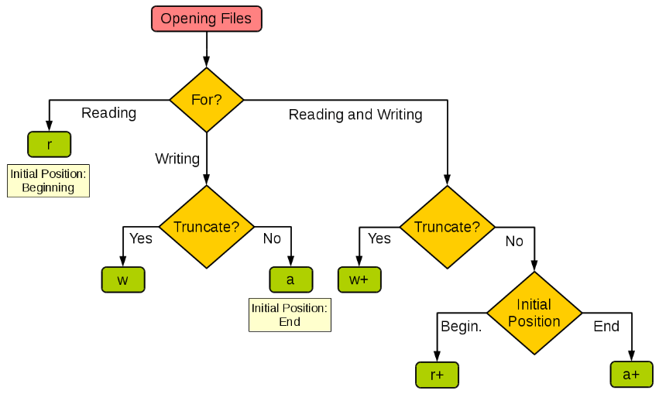
Chapter 7 Files
open()

Slide 5

Chapter 7 Files
open()

Slide 6
Chapter 7 Files
open()
buffer: buffering is an optional integer used to set the buffering policy. Pass 0 to switch buffering off (only allowed in binary mode), 1 to select line buffering (only usable in text mode), and an integer > 1 to indicate the size in bytes of a fixed-size chunk buffer. When no buffering argument is given, the default buffering policy works as follows:
Binary files are buffered in fixed-size chunks; the size of the buffer is chosen using a heuristic trying to determine the underlying device’s “block size” and falling back on io.DEFAULT_BUFFER_SIZE. On many systems, the buffer will typically be 4096 or 8192 bytes long.
“Interactive” text files (files for which isatty() returns True) use line buffering. Other text files use the policy described above for binary files.
encode: encoding is the name of the encoding used to decode or encode the file (it only be used in text mode)
errors: errors is an optional string that specifies how encoding and decoding errors are to be handled—this cannot be used in binary mode

Slide 7
Chapter 7 Files
open()
newline : newline controls how universal newlines mode works (it only applies to text mode). It can be None, '', '\n', '\r', and '\r\n'.
None: if newline is None, universal newlines mode is enabled. Lines in the input can end in '\n', '\r', or '\r\n', and these are translated into '\n' before being returned to the caller.
'': If it is '', universal newlines mode is enabled, but line endings are returned to the caller untranslated.
closefd: True: default value, it means a file name was given; False: a file descriptor was given.
opener: A custom opener can be used by passing a callable as opener
Notes:
'\r'是回车，前者使光标到行首，（carriage return） '\n'是换行，后者使光标下移一格，（line feed）
\n: UNIX 系统行末结束符 \r\n: window 系统行末结束符 \r: MAC OS 系统行末结束符

Slide 8

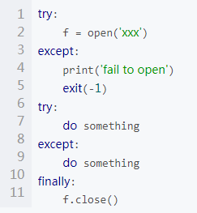

Chapter 7 Files
open()

Slide 9
Chapter 7 Files
file object
file.close()
file.flush()
file.fileno()
file.read([size])
file.readline()
file.readlines()
file.seek(offset[, whence])
file.tell()
file.truncate([size])
file.write(str)
file.writelines([ str ])

Slide 10
Chapter 8 OS and Errors
os.mkdir(path)
os.rmdir(path)
os.remove(file)
os.rename(src, dst)
os.getcwd()
os.chdir(path)
os.getenv(key)
os.getlogin()
os.getpid()
os.getuid()

Slide 11
Chapter 8 OS and Errors
assert
assert <expression>
if not <expression>:
raise AssertionError
raise
raise <Exception>
Notes:
https://docs.python.org/3/library/exceptions.html#bltin-exceptions

Slide 12
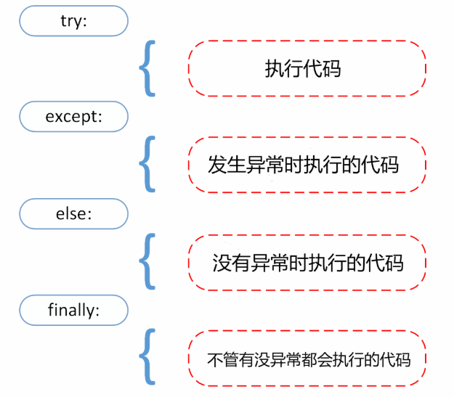
Chapter 8 OS and Errors
try
Notes:
https://docs.python.org/3/library/functions.html

